Slide 1
Disclosure of speaker's interests
No (potential) conflict of interests
Relations that could be relevant for the meeting¹
N/A
Sponsorship or research funds²
Payment or other (financial) remuneration³
Shareholder⁴
Other relation, viz. …⁵
- UK Research and Innovation (UKRI)
- N/A
- N/A
- N/A

Slide 2
The experiences of people with intellectual disabilities in England and Scotland during COVID-19

Slide 3
Research partners
LSHTM/ICED: Tom Shakespeare, Shaffa Hameed, Nat Scherer, Veronika Reichenberger
University of Glasgow: Nicholas Watson, Phillipa Wiseman, Jane Cullingworth, Richard Brunner, Nicola Burns, Charlotte Pearson
Project funder
UK Research and Innovation (UKRI)
Project outline
70 people with disabilities and 28 disability organisations interviewed
Two rounds: April-June 2020 and February-April 2021
Notes:
Unfortunately we are still analysing round 2 data, so this is predominantly a look at Round 1 and early experiences of the pandemic
Use of the term learning disabilities

Slide 4
Background
1.5 million people with intellectual disabilities in the UK
Scotland: 3x more likely to have severe symptoms; 2x more likely to die
England: Number of deaths twice the rate of general population
Notes:
1.5 million people with intellectual disabilities in the UK.
Learning Disabilities Mortality review (LeDeR) in England has shown increased risk of mortality year on year
Exposed in COVID
In Scotland, PWID 3x more likely to have severe symptoms and 2x more likely to die
In England, the number of deaths among PWID was twice the rate of general population
35% of PWID who died were in residential settings
Past this, important to understand experiences across key life areas

Slide 5
Methods
24 participants with an intellectual disability
13 adults
6 caregivers of adults
5 caregivers of children
12 key informants from organisations of and for people with disabilities
Interviews conducted via Zoom or, where requested, email
Key areas explored: work, education, leisure, social care, health and government response
Notes:
Within the broader project of 70 participants and 28 organisations
Range of impairments, ages etc.
71% Scotland, 29% England
63% female
63% had another impairment, e.g. mental health, autism, sensory, physical
12 key informants with people with intellectual disabilities listed as members
- Not much time, so going to have to give a quick and shallow look at some of the findings

Slide 6
Results: COVID measures/information
Information on the virus and measures was often inaccessible
“R: They sent out forms. They’re not in large print, and quite often they use giant words. Shouldn’t they have made Easy Read versions for people?
I: Have they provided any information for people with learning disabilities on COVID?
R: They sent forms to everybody. But I got the same form Angie [her friend] got… It would have been better if they did, like, Easy Read versions and stuff.”
(Susan, Scotland)
Notes:
Information sources were inaccessible and were not tailored to the needs of this group
They used inappropriate language, both in written form and also in television announcements
Often Easy Read versions that were available were only available online and were difficult to find behind lots of webpages
For some, this created fear, anxiety and a limited understanding of the measures. Examples of participants causing themselves harm, by using bleach to clean themselves and their home excessively
Third sector organisations were the ones to step in with appropriate information
They developed and provided Easy Read material
Some held Zoom sessions to explain the virus
Organisations such as Beyond Words have produced accessible materials

Slide 7
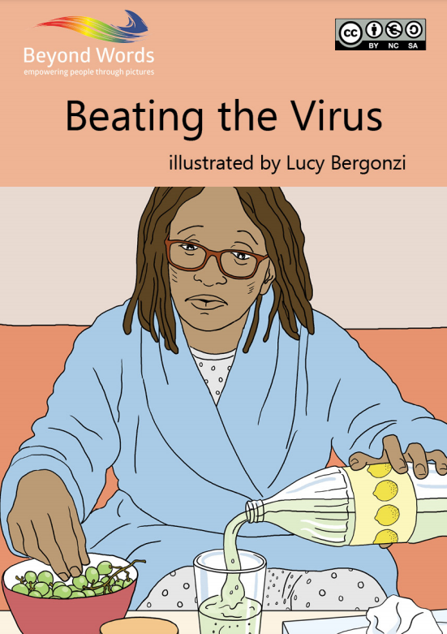
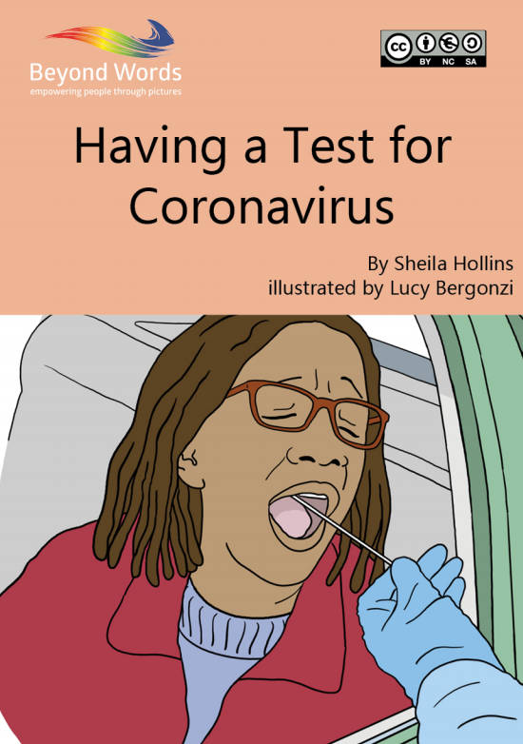
Results: COVID measures/information
Notes:
So some good examples, but coming from third sector organisations, rather than government

Slide 8
Results: Disrupted routines and lost activities
Participants missing their routines and activities
At a loss without routine
Lost independence and confidence
Isolated
Feeling useless
Third sector have stepped in online
BUT digital exclusion is an issue
Notes:
We have all been affected, but people with intellectual disabilities have felt this very keenly, with day centres, skills-building classes and similar activities such a part of routine and daily life for many.
And for many, this routine is very important. Without it, many were at a loss and many were distressed
Many reported feeling a loss of independence and confidence, and were anxious about transitioning back into the community and old routines
This was a common theme also, that many felt less stimulated, and felt they had lost hard-fought gains in skills, confidence etc.
They felt isolated, especially those that rely on day centres and these activities for their social life. Lots of organisations seeing members exhibit mental health issues
Feeling useless and worthless, especially if not working or feeling like they are contributing
Again, third sector organisations stepped in to fill the void, with online zoom activities, such as quizzes, cooking, book clubs etc.
BUT digital exclusion is huge. Reports that only 40% of people with intellectual disabilities have access to technology
And not everyone that does is comfortable with it as a mode of communication

Slide 9
Results: Social care and reversion to family
Social care packages removed
Virtually overnight for many
No consultation
“[name of provider], who provide most of Maurice’s care, phoned me up and said:
‘Obviously this virus is getting more serious, so we’ve had to prioritise the support we provide, and in two days, Maurice’s care will be ceasing altogether, and it’s over to you. You need to now cover all of it.’
So as you can imagine, that was a surprise.”
(Abby caregiver of Maurice, Scotland)
Notes:
Many receive no support at all, and are really struggling
For those that did, social care dissolved away
Social care packages were removed overnight, including day centres and domiciliary care at home
Families were expected to pick up the slack
There was no consultation on what individuals and families needed
Families not prepared for 24/7 care
Very few care agencies even maintained contact and social workers often didn’t know what advice to give, although community learning disability nurses and volunteers have been great
Burden on families and caregivers themselves, and the stress/burnout/mental health issues that come with this whilst trying to work from work etc.
Many caregivers cant be as attentive or stimulating and this has a negative impact on PWID. Comes back to the idea of lost gains, as mentioned earlier
Very little guidance provided by the government for care providers, with many participants feeling they just went through the motions and completed tick-box exercises
Little guidance on having carers come into the home and what measures should be in place, with regards to PPE etc.
There was no consistency of care and often different people each time, increasing risk of virus
Burden put on families to come up with measures and rules in the home

Slide 10
Results: Cuts to funding
Funding is being re-assessed
Many worried that funding will be cut in the future
Substantiated by key informants
Notes:
Worries about funding cuts
Substantiated by key informants
Families have proven they can care, and the government is asking organisations and local authorities to now see where they can cut costs
So instead of support being increased, we are seeing support reduce, both during the pandemic and going forwards

Slide 11
Results: COVID policy/government response
Ultimately, people with intellectual disabilities feel forgotten about
Not seen in society and easy for government to forget about them
“When I watched them (news briefings) with mum - religiously as well, because we needed to know what was happening - every time we watched them, I never once heard the word learning disability. We were completely forgotten about.
*voice breaking* Do they ever think about people like us? …. We’re missing out on our social care, and our healthcare. Because of the coronavirus, because of shielding. But could they care less? No. Do they care? No.”
(Kelly, England)
Notes:
Their needs were not considered in the early stages of the pandemic
There was a real sense that they had been forgotten and were seen as expendable

Slide 12
Summary
Initial government response inadequate
People with intellectual disabilities were forgotten
Need to build back better
Notes:
This has exposed and amplified a number of issues for people with intellectual disabilities, who have seen their care eroded in recent years, and who are unseen in society
We’ll be interested to see how these issues have maintained over the course of a year, when looking at second round data
We saw heavy public advocacy and news around vaccines but this was coming very late into the pandemic and too late for many
But from this data, it is clear that there is a need to build back better, with government policy that supports those in need
Definitely stop movement towards reduced social care
An opportunity to re-think a person-centred approach
As ever, working with people with intellectual disabilities and their families is key

